Slide 1

Welcome.
Mesocycle is an easy to use app that customizes and auto programs your workouts for an entire month.
You may be asking yourself, what the heck is a mesocycle?
A mesocycle is a specific block of training designed to accomplish a certain goal, typically in a 3-4 week timetable. In addition, …. blah, blah, words, words, more words.
Let’s get to work. You got this.
Continue

Slide 2
< Back
Let’s Begin.
We’ll need a few pieces of information like which movements you prefer based on equipment availability and your 10 repetition maximum (10RM) for each movement in order to customize your training program.
Don’t go and start maxing out just yet big guy, just give us a conservative guestimate. You can adjust it later.
You have some decisions to make. Time to put on your thinking cap
Continue

Slide 3
< Back
Choose your exercise movement below for Day 1 of each week.
Chest Upper Focus
Movement
(Choose From Drop Down Menu)
Incline Push
Incline Medium Grip Bench Press
Chest Isolation
Flat Dumbbell Fly
Horizontal Push
Medium Grip Bench Press
Rear or Side Delts
Dumbbell Side Lateral Raise
Horizontal Pull
Cable Row
Continue

Slide 4
< Back
Estimate your 10 rep maximum (10RM) for Day 1 movements.
Movement
10RM
(Input in the fields)
Incline Medium Grip Bench Press
155
Flat Dumbbell Fly
40
Medium Grip Bench Press
160
Dumbbell Side Lateral Raise
20
Cable Row
165
Continue

Slide 5


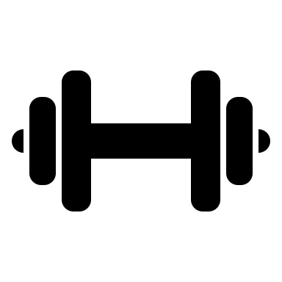



Week 1 - Day 1
Rep Range: 12 – 20 reps | Rest Time Between Sets: 2 – 5 min
Movement
Sets
Weight
Rep
Count
Instructional Video
Incline Medium Grip Bench Press
3
130
15
Flat Dumbbell Fly
3
35
14
Medium Grip Bench Press
3
135
17
Dumbbell Side Lateral Raise
2
15
18
Cable Row
2
140
18
10RM
HOME
LOG IT
STATS

Slide 6

10RM
HOME
WORKOUTS

Slide 7
10RM
HOME
WORKOUTS

